Slide 1
Introduction to Engineering
Ashima Fatima 21BAI1830

Slide 2
CHAPTER 1: DETAILS ON THE ACTIVITIES INVOLVED DURING THE INDUCTION PROGRAMME
Its timeline is:
Jan-Feb: Registration
Feb-Mar: Training
July-Aug: Super dream/dream campus requirements
Sep: IT service companies’ requirement
Sep – Dec: Super dream/ dream campus requirements
Jan-May: campus recruitment (all categories)
1. Introduction to Year-round Sports Events
2. Career Development Centre (CDC)
The CDC oversees all campus placements.
The criterion for participation is achieving 60% and above in academics from 10th with a maximum of 2 years academic gap.
3. Office of International Relations
Aims at faculty and student exchange, joint R&D and joint programs. The office serves as the nodal point for information and assistance to all international students. It also coordinates with schools to arrange international conferences/ seminars/ lectures, prepares MoUs, arranges internships to students as well as the semester abroad program.

Slide 3
Additionally, it supports the students visiting universities abroad as well as helps in the logistic arrangements and accommodation for delegates, identifies funding opportunities and adjuncts professors for various programs.
i. Semester Abroad Program (SAP)
Students can go for a period of 5/6 moths to do their projects with a selected institution and have an opportunity to work with scientists abroad with cutting edge technologies.
ii. International Transfer Program
Students can transfer to a partner university for a minimum of 2 years of study. Partner universities include, Plymoth, POSTECH, Sookmyung Women’s university.
iii. Short Term Courses Organised for Students from Deakin University, Australia
The university conducts the Big Data Analytics course which focuses on advanced data analytics and for the last two years has been conducted online.
4. NCC (National Cadet Corps)
Students are given basic education about high level military training and social service. It takes place for 3 years and consists of: parade, training on foot and arms drill, firing, rallies and social services such as blood donation camps.

Slide 4
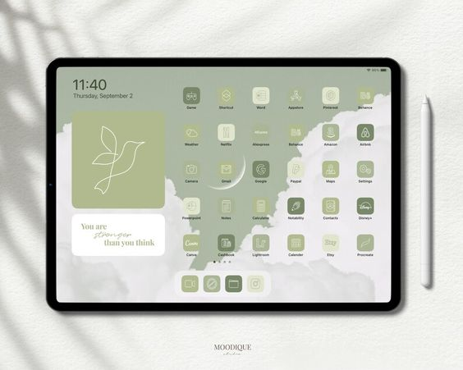
CHAPTER 2: LEARNINGS DURING THE GENERAL INDUCTION
1. Ways of Conducting Learning Digitally
smart boards, the virtual classroom, 24x7 virtual labs, digital lecture capturing.
students are requested to mind their digital footprint, explore MOOCs and the digital library online and asked to make a digital portfolio of their studies and other extracurricular work. Students will also be examined online via exams on digital tablets and online examinations
2. VIT’s Established Framework for Digital Efficiency
digital learning management system that includes Moodle, Google Classrooms and MS teams.
On top of this is the VTOP portal which contains a slot-wise timetable, both student and parent logins plus an online fee payment feature.
Aside from these are the online proctored exams, smart board tools, digital discussion tables and multimedia and ICT for faculty use in order to digitalise their teaching.

Slide 5
VIT is a MERU i.e. a multidisciplinary education and research university with flexibility for students to do courses of higher level including minors, honours and research.
4. Fully Flexible Credit System
This system allows fast learners to finish all their credits early to do internships/ research in their leftover time at the university and students who failed their courses to re-register in the upcoming semesters or the summer.
The program credit structure is built is to include the foundation core, discipline linked engineering sciences, discipline core, discipline electives, open electives, project & internships all which total to 151 credits and aside from that also require non-graded credits worth 11 credits.
The course structure consists of lectures, tutorials, practical hours.
Minimum credits per semester is 16 and maximum is 27 and one needs at least 20 credits if aiming for a GPA greater than 4.0.
For the first 3 days of a semester, the add/drop options are still open after which they close. One can withdraw from a course after CAT1
Assessment structure includes CAT1 – 15%, CAT2 – 15%, 3 digital assignments – 30% and then the FAT for 40%.
A backlog is a N or F grade.
Audit courses one can take without minding the grade and is restricted to just one course per semester.
For a specialization you study 18-20 credits in a focused niche area on top of the 9+ credits of a discipline elective.
A double major will require an extra 30 credits and will take beyond 4 years.

Slide 6
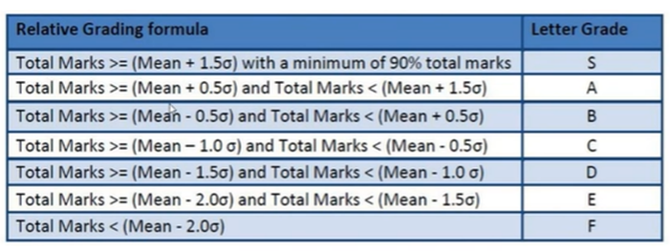

Grade Classifications
In format: Grade – Grade Point – P/F
S – 10 – PASS
A – 9 – PASS
B – 8 – PASS
C – 7 – PASS
D – 6 – PASS
E – 5 – PASS
F – 0 – FAIL (haven’t scored min marks)
N – 0 – FAIL (haven’t cleared a component)
W – withdrew
U – successfully completed an audit course
Y – yet to complete the course component
Grade System
Absolute grading is taken if the class strength is less or equal to 10 students or else relative grading is taken. Grade classification for a relative grading system is shown below:
Other Facilities Provided
These include revaluation, REFAT, scribe, transcripts in VTOP and grade sheets.

Slide 7

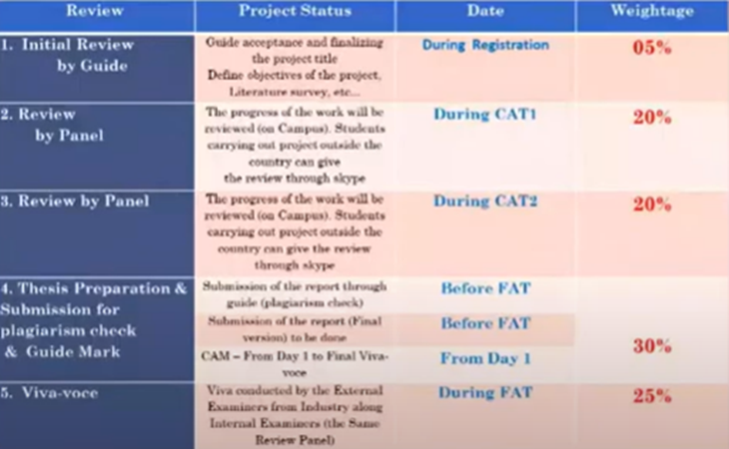
CHAPTER 3: LEARNINGS DURING THE DISCIPLINE-SPECIFIC PROGRAM
Schedule for the Review
1. SAP During Pandemic
The virtual internship in universities
abroad/ industries was still
conducted
2. Capstone Project
Through the Capstone project, the student is expected to get prepared for engineering practice in the relevant industry.
The project can be an individual work or a group project with a maximum of 3 members.
The project can be carried inside or outside the university, in any relevant industry/ organisation/ institution on the recommendation and approval of the Dean of the school.

Slide 8

Undergraduate Research Experience (URE)
There are 4 types of URE.
URE 001 – only students having a CGPA of 8.50+ will be qualifies for this award and will work with a faculty member towards a contemporary research position. This work will be marked on the grade sheet as a ‘P’.
URE 002 – awarded to exceptional quality and quantity of research work and will be judged both internally as well as by an external member from a reputed institution.
URE 003 – requires a minimum of 1 year duration.
URE 004 – for innovative projects.
The process is set out as: 1. Choose topic of interest 2. Approach a faculty 3. With the support and guidance of faculty complete the research work 4. Apply for URE 5. Evaluation by a panel of experts.
VPROPEL
Gives a problem of the day for students to solve.

Slide 9
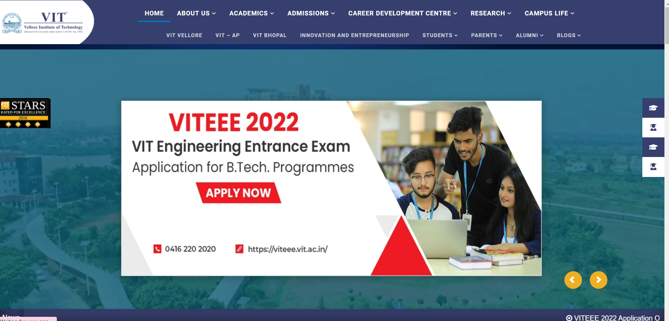
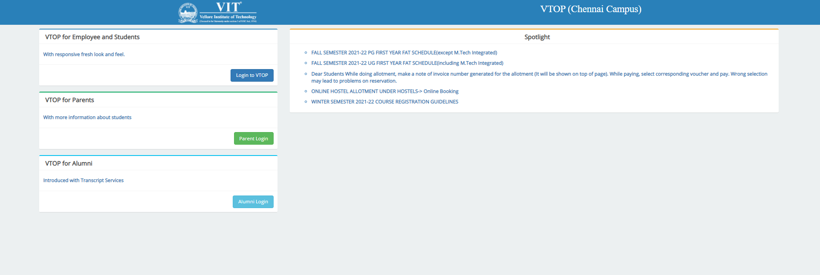
CHAPTER 4: LEARNINGS DURING THE INSTITUTIONAL WEBSITE
2. VTOP
Main portal for all information regarding the student. Can find their student profile, passwords, timetable, proctor and course information, grade reports, attendance reports, and course resources here. There is also a feature for online hostel booking and online fee payment on the site. Fees receipts can be found on this website too.
1. VITCC Intranet
intranet.vit.ac.in – can find all notification about the university here
3. VIT Chennai Events
Vitchennaievents.com – can find information and payments about various events conducted

Slide 10
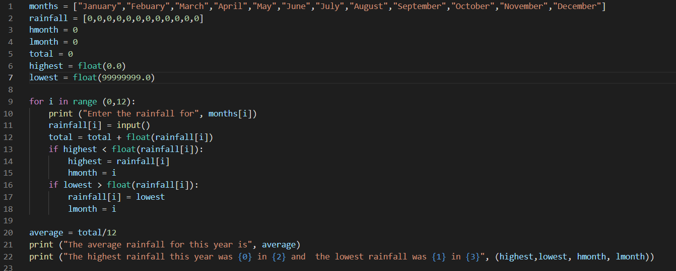
CHAPTER 5: LEARNINGS FROM THE DIY PROJECT
For my Do-it-yourself project, I decided to write the python code for the following scenario: The amount of rainfall in each month is recorded. From this data, output the average rainfall of the year as well as the highest and lowest rainfall in the year.
Through this project, I was able to refresh my previous knowledge of coding which will be useful in my python coding classes.

Slide 11
CHAPTER 6: ANY OTHER GENERAL OBSERVATIONS
Faulty Structure at VIT
The Office of Student Welfare consists of the student council, clubs & chapters, student councillors, extension activities, campus amenities, scholarship & achievements, health & insurance, proctor scheme & other support.
The student council is involved in university events planning and organisation, internal quality assurance cell, program representatives, participation in committees (hostel, campus development, library, etc) and sports & cultural activities.
There are various outdoor and indoor sports facilities and clubs.
The student council oversees the NCC, NSS, clubs & chapters and special teams.
A new building is being built to accommodate resources for the special teams and encourage new teams to be formed. Main internal events include Vibrance and technoVITe.
Counselling
VIT has 2 on campus councillors. One of them specializes in academic counselling and the other in emotional counselling. You can get anonymous counselling and the data will not be shared with any other parties. The academic counsellor can help with time managements and other academic performance related issues and the emotional counsellor can help recommend psychiatrists and therapists if you are struggling with any mental health problems.

Slide 12

Proctor Scheme
Students meet proctors a minimum of 3 times per semester who monitor and periodically communicate the student’s performance to their parents. They guide proctees about academic activities such as course registration, rules and regulations governing the programme, update the address and phone numbers of proctees periodically and oversee leave approval.
Monitoring Committees
There are 3 monitoring committees – Internal Complaints Committee, Anti-discrimination Committee and Anti-ragging Committee.
VIT Alumni Association (VITAA)
VITAA has domestic and international chapters. Its eligibility is the procurement of a degree from VIT for a duration of minimum 2 years. The annual alumni meet is the 26th January of every year at the Vellore Campus. There is a VITAA portal for the alumni network at www.vitaa.org

Slide 13

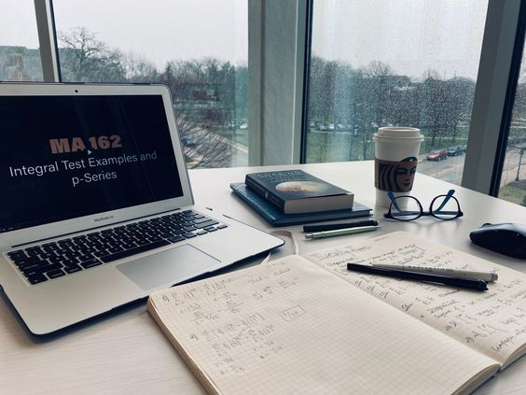
CHAPTER 7: INITIAL LEARNINGS AND OPPORTUNITIES FOR SELF DEVELOPMENT
2. Ways to prepare for campus placements
Ways to prepare include:
preparing for aptitude tests, improving soft skills, brushing on fundamentals,
creating a digital footprint, focusing on maths, participating in online contests (Facebook, Hackercup, Google CodeJam, Google APAC, Kickstart),
having a Linkedin Account, practicing with algorithms and data structures, getting into leaderboards (Hackerrank, codeforces, codechef, etc) and learning more programming languages.
1. Opportunities for students
Students are provided internships with local industry and businesses as well as incubation centres i.e. technology development centres.
In order to build a stronger industry link while still studying, VIT conducts joint projects and publications with industries that students can participate in.

Slide 14

Innovation and Start-up Ecosystem at VIT
VIT has opened a start-up incubator called ‘V-nest’ to encourage the starting of businesses by university students. The start-up incubator conducts workshops and lecture sessions on innovations and business start-ups. The incubation selection process is as follows:
The KANO model can help illustrate the graph on customer emotional satisfaction and need fulfilment. The best service/product is one that satisfies both constraints.
The Johari window helps illustrate the way ideas exist in a table which considers if an idea is known to self or not and if it is known to others or not. Success is a combination of routine work then continuous improvement and then innovation in that order.
Problem solving is a step-by-step process consisting of one empathising, then defining, ideating, turning idea into a prototype and then testing, re-empathising and re-defining and so on in a loop.
STEP 1 – application submission by the applicant
STEP 2 – screening of the application
STEP 3 – review of the application by expert members
STEP 4 – interview of the applicant by expert members
STEP 5 – in principle approval or rejection
STEP 6 – negotiation of terms and conditions
STEP 7 – signing of the incubation agreement
STEP 8 – services provided by the incubation centre
STEP 9 - graduation from the incubation centre

